Slide 1
Data Structures and Algorithms (CCE 221)
By
Dr : Asmaa Aly Hagar

Slide 2
Course Academic Calendar
Week Num | Date | Content
Week1 | 24/9/2025 | Introduction to Data Structures + Mathematics Review + Review of Concepts of ‘C++’
Week2 | 01/10/2025 | Sparse Matrix, Concepts of Class, and Analysis of Algorithms
Week3 | 08/10/2025 | Linked Lists
Week4 | 15/10/2025 | Stack
Week5 | 22/10/2025 | Queue
Week6 | 29/10/2025 | Trees
Week7 | 05/11/2025 | Midterm
Week8 | 12/11/2025 | AVL Trees
Week9 | 19/11/2025 | Priority Queues and Heaps
Week10 | 26/11/2025 | Graph
Week11 | 03/12/2025 | Searching and Sorting
Week12 | 10/12/2025 | Hashing

Slide 3
Lecture6

Slide 4
Contents of the Lecture
What is a Tree?
Tree Terminologies
Binary Tree
Types of Binary Tree
Binary Tree Representation
Operations on Binary Tree

Slide 5
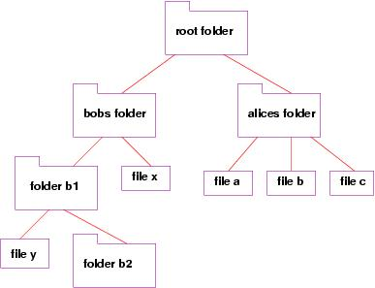

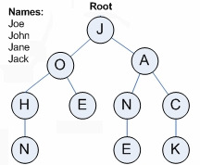
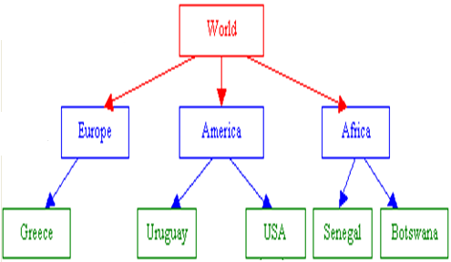
What is a Tree?

Slide 6
What is a Tree?
A tree is a powerful nonlinear data structure in which the elements are arranged in the parent and child relationship manner.
Trees are very flexible , versatile and dynamic data structure that can be used to represent data items possessing hierarchical relationship between the grand father and his children and grand children as so on.
In trees ADT (Abstract Data Type), the order of the elements is not important. If we need ordering information, linear data structures like linked lists, stacks, queues, etc. can be used.
Many real life problems can be represented and solved using trees

Slide 7
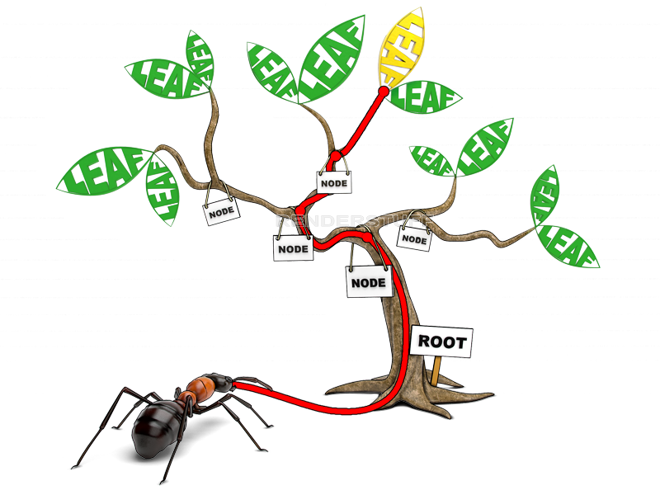
What is a Tree?
A tree is a collection of nodes.
The collection can be empty.
If not empty, a tree consists of:
  a node r (the root)
  zero or more nonempty subtrees T1, T2, ...., Tk, each of whose subtrees are connected by an edge from r.
  Note: In a tree with n number of nodes, there are exactly (n-1) number of edges.

Slide 8
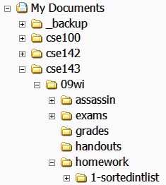
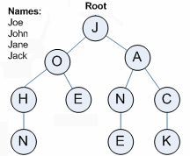
Trees in computer science
Folders/files on a computer
Family or organizational charts
Compilers: expression parse Tree
a = (b + c) * d;
=
a
*
+
d
b
c

Slide 9
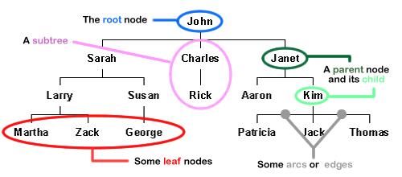
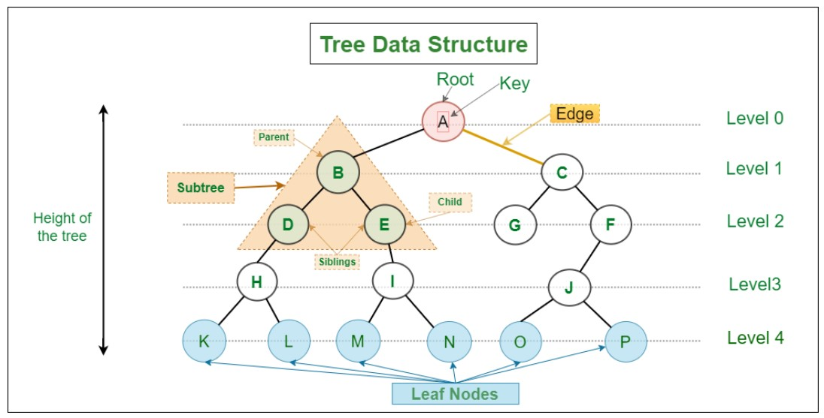
Tree Terminologies

Slide 10
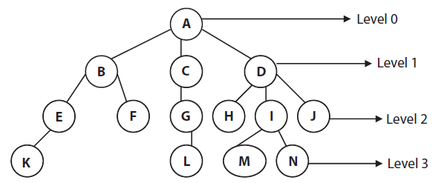
Tree Terminologies
NODE: Each element of a tree is called as node. It is the basic structure in a tree. It specifies the information and links(branches) to other data items. In the above diagram 14 nodes are there.
ROOT: It is specially designated node in a tree. It is the first node in the hierarchical arrangement of data items (the node with no parents). In the diagram A is the root node.
PARENT: Parent of a node is the immediate predecessor of a node. Here B is the parent of E and F.
CHILD: Each immediate successor of a node is known as child. In the above diagram B, C, D are children of A.
SIBLINGS: The child nodes of a given parent node are called siblings. In the figure H, I, J are siblings.

Slide 11
Tree Terminologies
DEGREE OF A NODE: The number of sub-trees of a node in a given tree is called degree of that node.
In the figure
    The degree of node A is 3
    The degree of node B is 2
    The degree of node G is 1
    The degree of node F is 0
DEGREE OF TREE: The maximum degree of nodes in a given tree is called the degree of the tree. In the figure the maximum degree of nodes A and D is 3. So the degree of Tree is 3.
TERMINAL NODE: A node with degree zero is called terminal node or a leaf. In the figure K, F, L, H, M, N, J are terminal nodes.

Slide 12
Tree Terminologies
NON-TERMINAL NODE: Any node (except the root node) whose degree is not zero is called as non-terminal node. In the above tree B, E, C, G, D, I are non-terminal nodes.
LEVEL: The entire tree structured is leveled in such a way that the root is always at the level 0, then its immediate children are at level 1, and their immediate children are at level 2 and so on up to the leaf node. The above tree has four levels.
EDGE: Edge is the connecting line of 2 nodes. CG is an edge of the above tree.
PATH: Path is the sequence of consecutive edges from the source node to the destination node. In the above tree the path between A and M is (A,D),(D,I),(I,M).

Slide 13
Tree Terminologies
DEPTH: The depth of node n is the length of the unique path from the root to n. The depth of E is 2 and B is 1.
HEIGHT: The height of node n is the length of the longest path from n to leaf. The height of B is 2 and F is 0.
Size : the number of nodes in a tree.
Note: The set of all nodes at a given depth is called the level of the tree

Slide 14
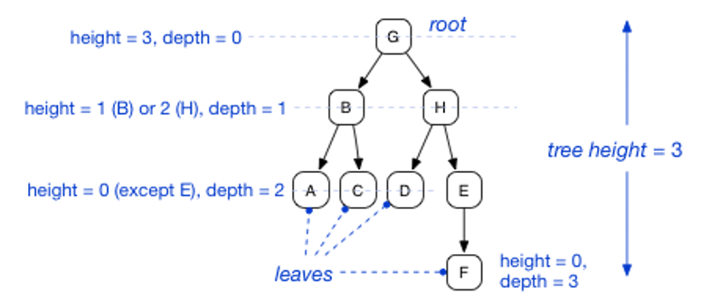
Tree Terminologies
Height of the tree is the maximum height among all the nodes in the tree and depth of the tree is the maximum depth among all the nodes in the tree.
For a given tree, depth and height returns the same value. But for individual nodes we may get different results.

Slide 15
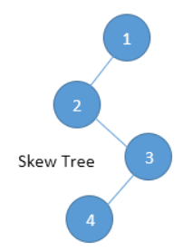
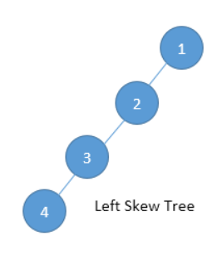
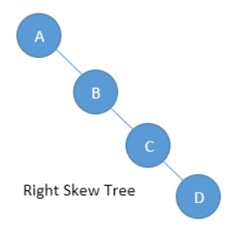
Tree Terminologies
If every node in a tree has only one child (except leaf nodes) then we call such trees skew trees.
If every node has only left child, then we call them left skew trees.
Similarly, if every node has only right child, then we call them right skew trees.

Slide 16
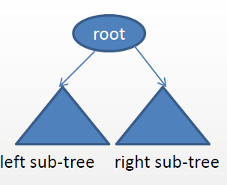
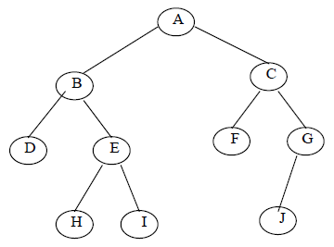
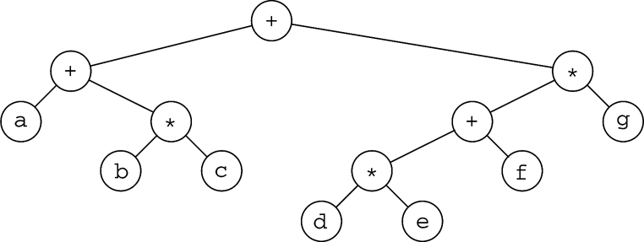
Binary Tree
Binary tree is a tree with restrictions, such that any given node can have at most two child nodes.
A binary tree consists of a set of nodes such that either :
    Tree is empty, or
    Tree is partitioned into three disjoint subsets:
        The root
        Two possibly empty sets that are binary trees, called the left sub tree of the root and the right sub tree of the root
Examples

Slide 17
Binary Tree
A binary tree with n nodes, n> 0, has exactly n–1 edges.
A binary tree of depth d, d> 0, has at least d+1 and at most 2^(d+1)–1 nodes in it.
If a binary tree contains n nodes at level L, then it contains at most 2n nodes at level L+1.

Slide 18
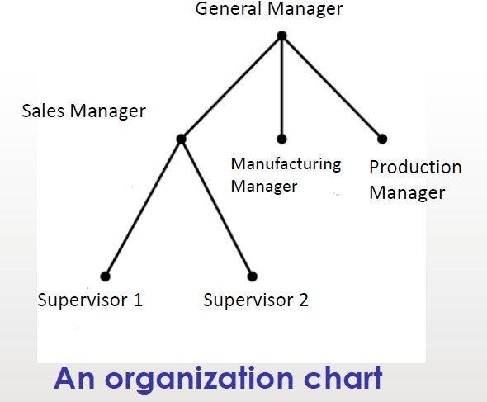
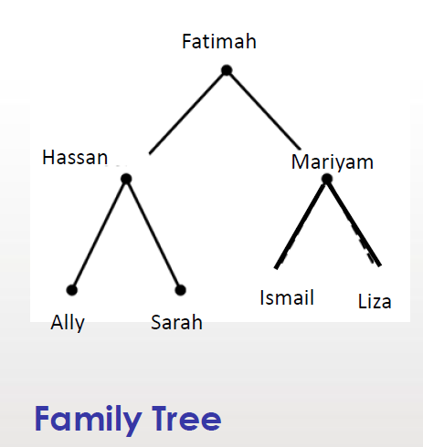
A General Tree vs A Binary Tree

Slide 19
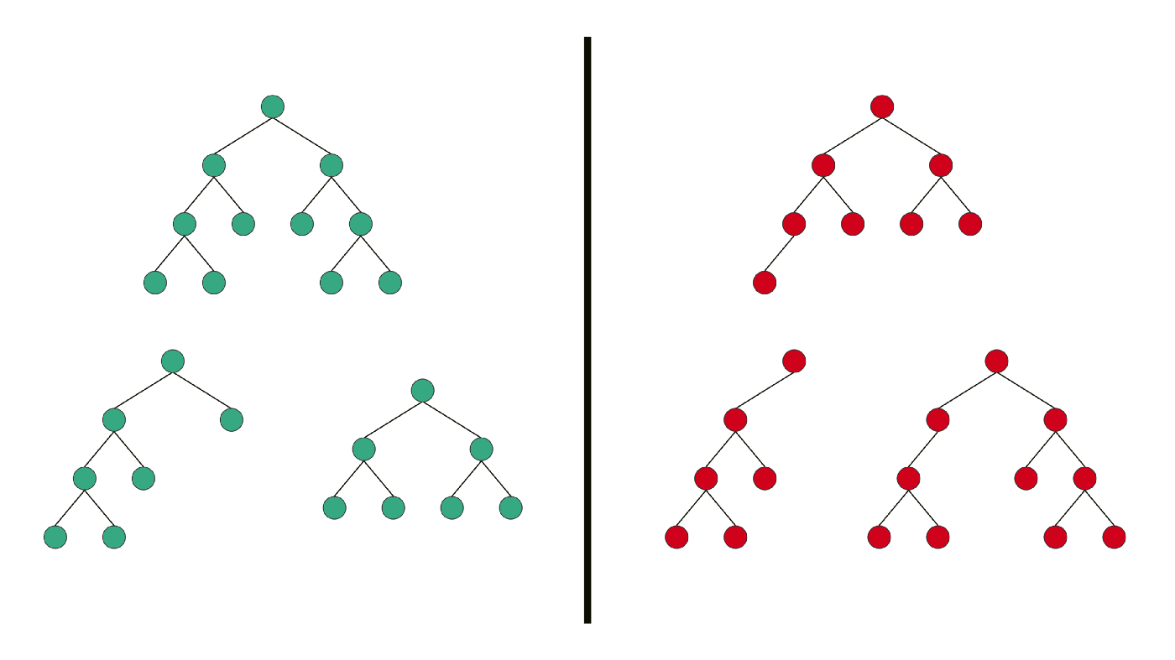
Types of Binary Tree
Strictly (Full) Binary Tree
It is a Binary Tree in which every node has 0 or 2 children — no node has only one child.
A binary tree is said to be strictly binary tree , if every non leaf node in a binary tree has non empty left and right sub trees .
They are also called 2 tree or extended binary tree.

Slide 20
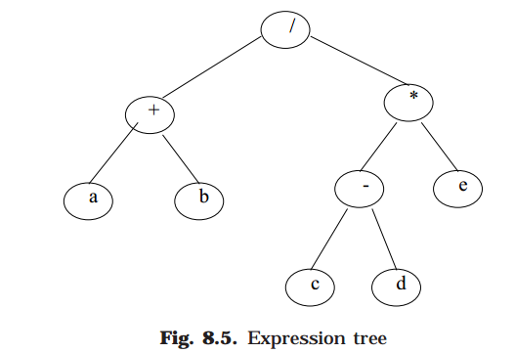
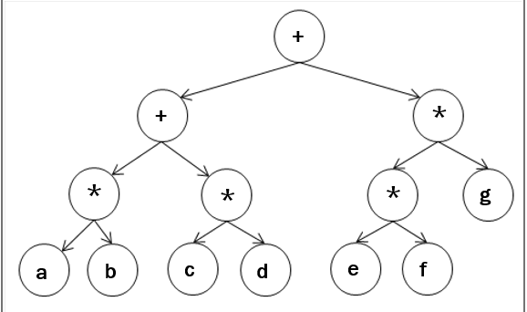
Application of Strictly Binary tree: Expression Tree
$$\left(a+b\right)/((c−d)∗e)$$
$$\left(a∗b+c∗d\right)+(e∗f∗g)$$

Slide 21
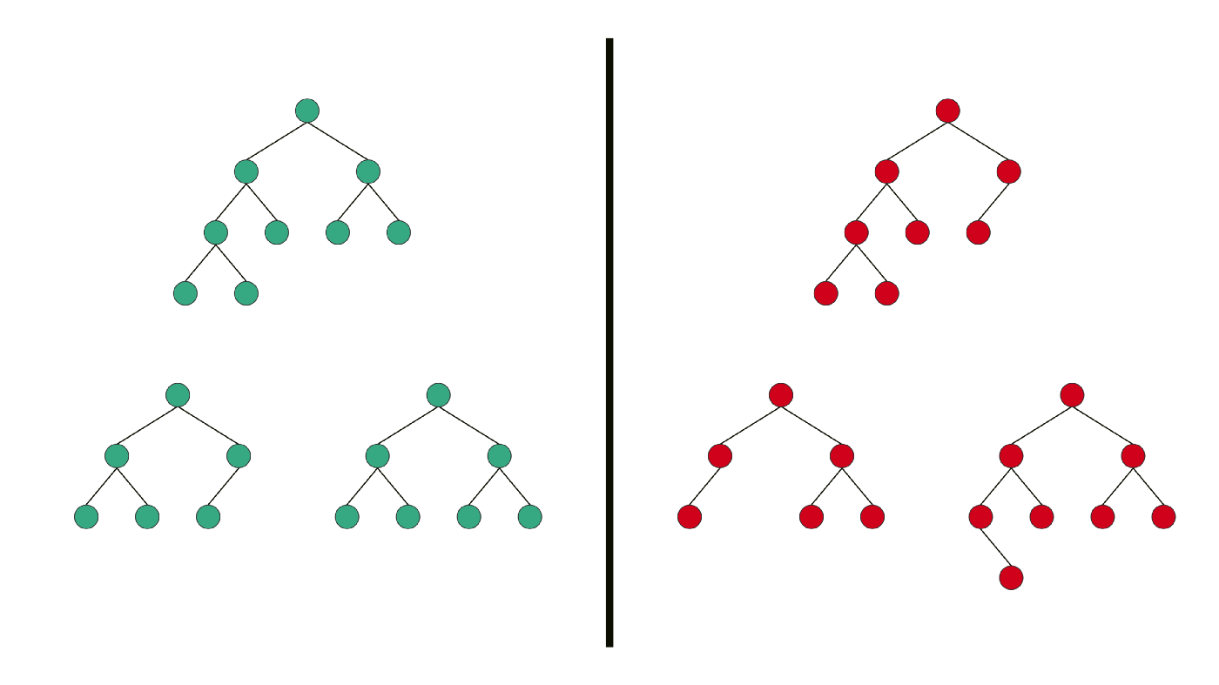
Types of Binary Tree
Complete Binary Tree
It has all levels completely filled with nodes (has 2^L node) except the last level and in the last level, all the nodes are as left side as possible (without any missing number in the sequence).

Slide 22
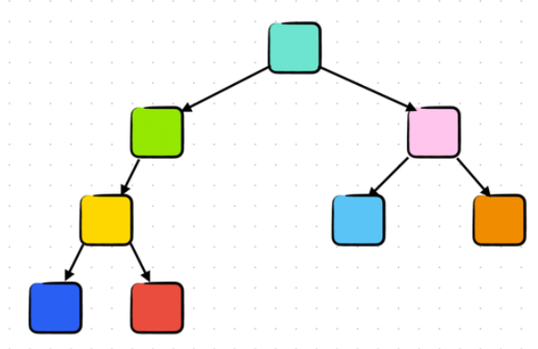
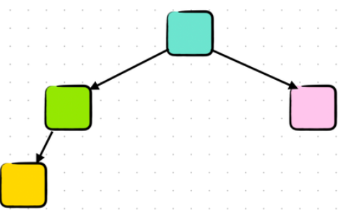
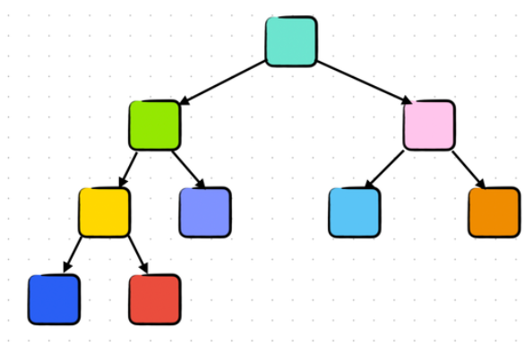
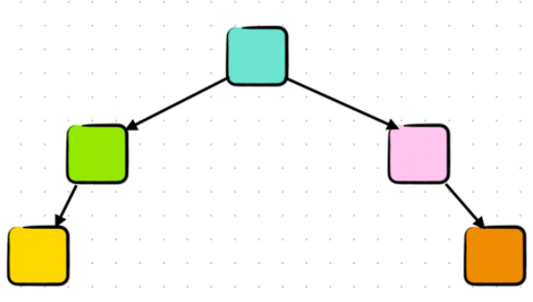
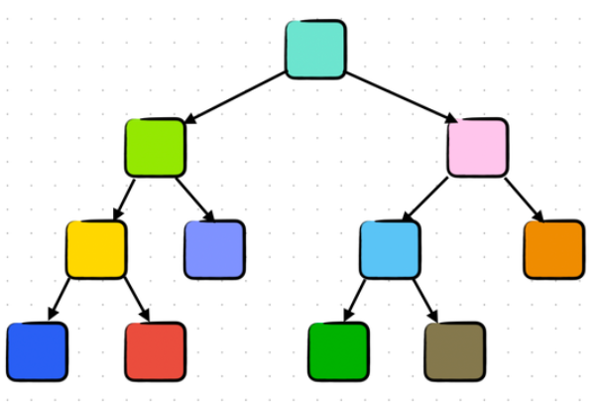
Quiz/5
B
D
Determine whether each of the following trees is full, complete, or neither.
A
C
E
Notes:
A -> complete and full
B -> not complete and not full
C -> not complete and not full
D -> complete and not full , E -> not complete and full

Slide 23
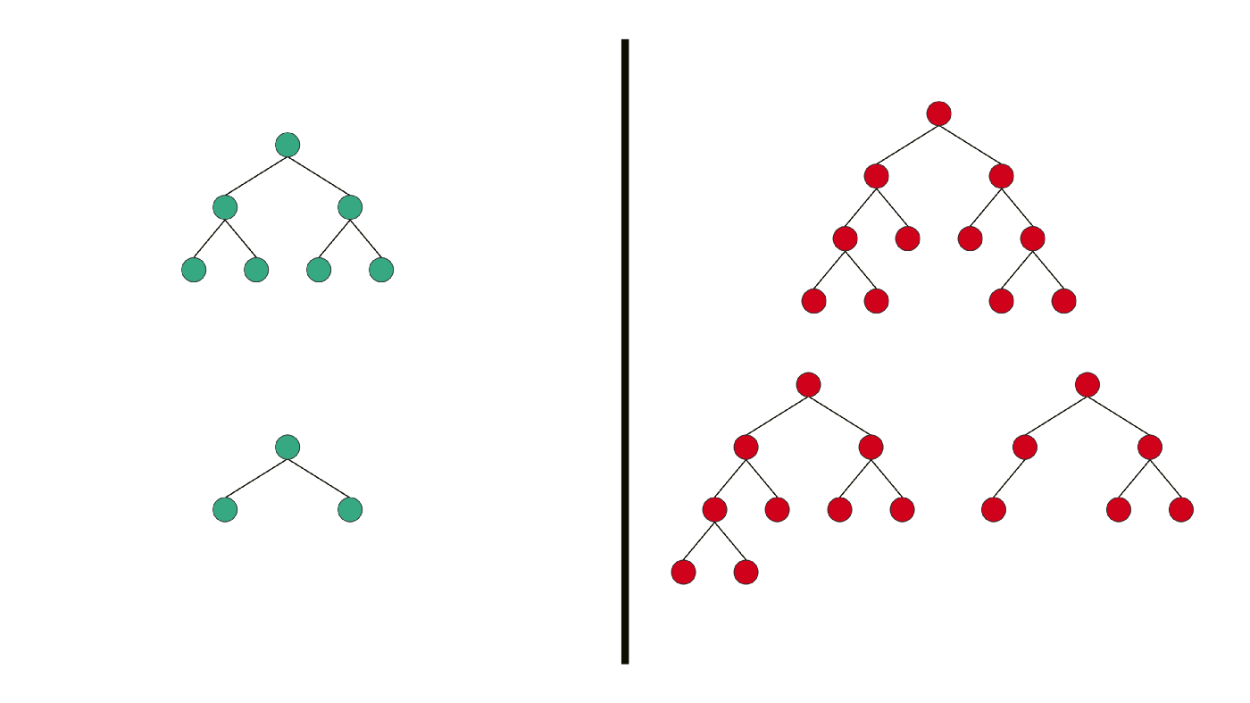
Types of Binary Tree
Perfect Binary Tree is a Binary Tree in which all internal nodes have 2 children, and all the leaf nodes are at the same depth or same level.

Slide 24
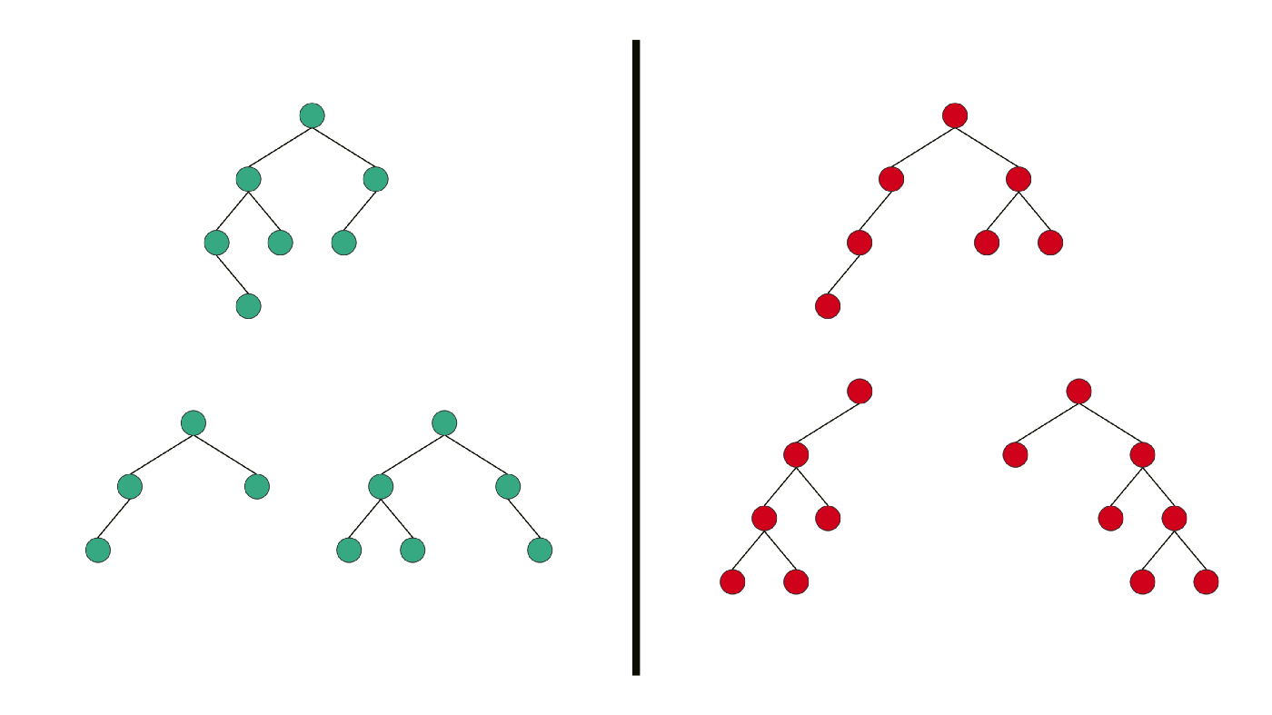
Types of Binary Tree
Balanced Binary Tree
  It is a Binary tree in which height of the left and the right sub-trees of every node may differ by at most 1.
  Complete binary trees are balanced.

Slide 25
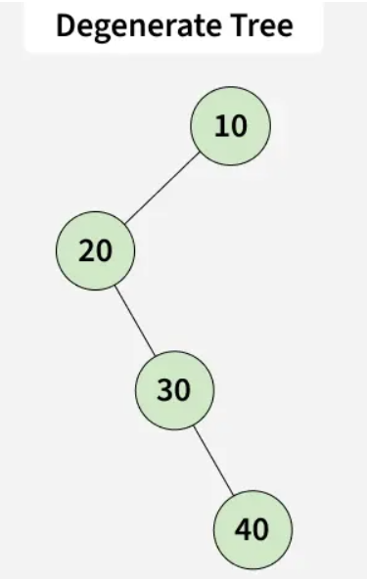
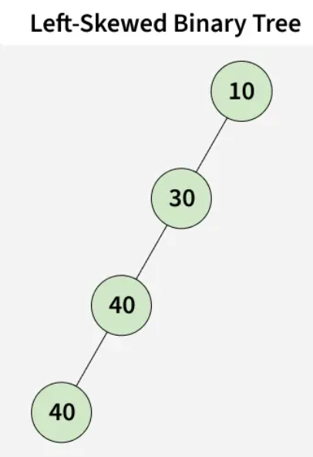
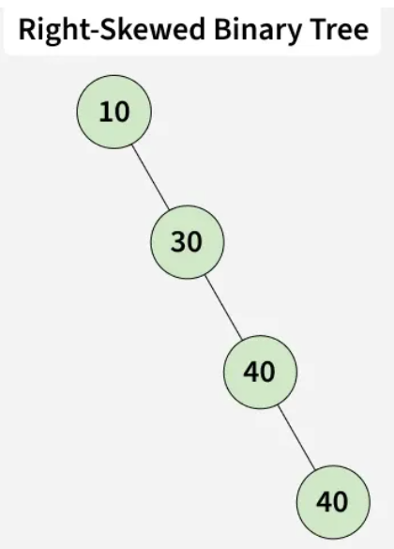
Types of Binary Tree
Degenerate (or Skewed) Binary Tree: Every parent has only one child — acts like a linked list.

Slide 26
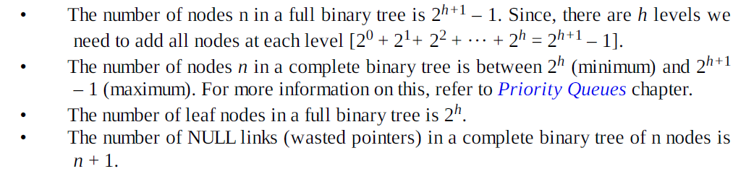
Properties of Binary Trees

Slide 27
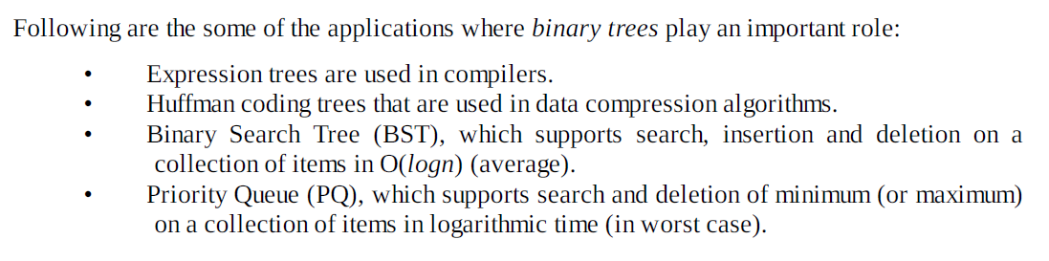
Applications of Binary Trees

Slide 28
Binary Tree Representation
A binary tree can be represented by using
    Array
    Linked List

Slide 29
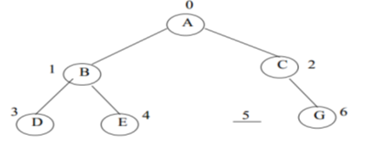
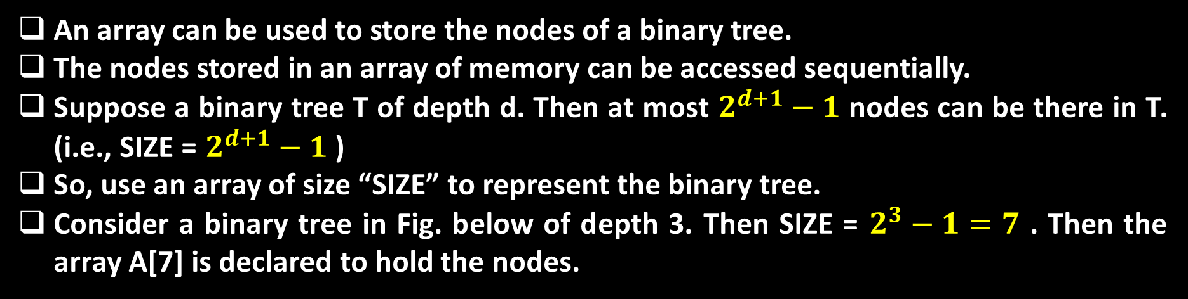
Array Representation of a Tree
An array can be used to store the nodes of a binary tree.
The nodes stored in an array of memory can be accessed sequentially.
Suppose a binary tree T of depth d. Then at most $2^{d+1}−1$ nodes can be there in T. (i.e., SIZE = $2^{d+1}−1$ )
So, use an array of size “SIZE” to represent the binary tree.
Consider a binary tree in Fig. below of depth 3. Then SIZE = $2^{3}−1=7$ . Then the array A[7] is declared to hold the nodes.
G

Slide 30
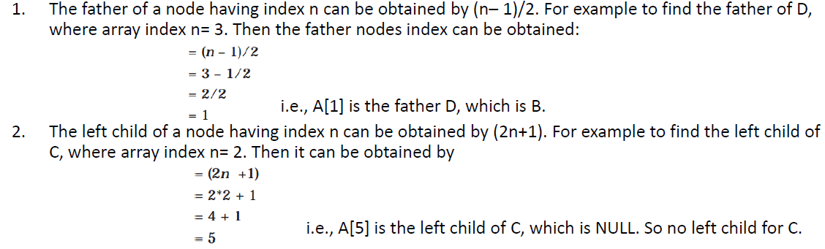
Array Representation of a Tree
To perform any operation, we often have to identify the father, the left child and right child of an arbitrary node.

Slide 31
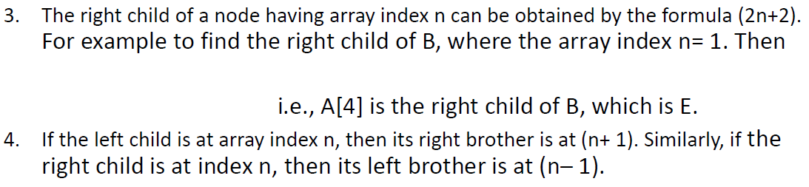
Array Representation of a Tree
The array representation is more ideal for the complete binary tree.
Fig 8.8 is not a complete binary tree. Since there is no left child for node C, i.e., A[5] is vacant. Even though memory is allocated for A[5] it is not used, so wasted unnecessarily.

Slide 32
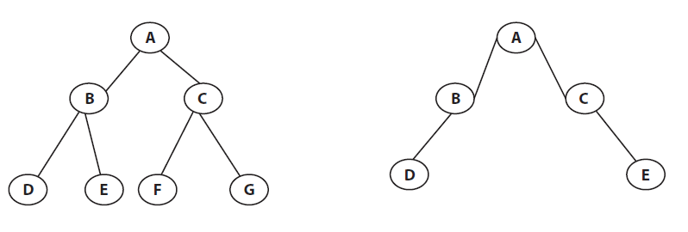
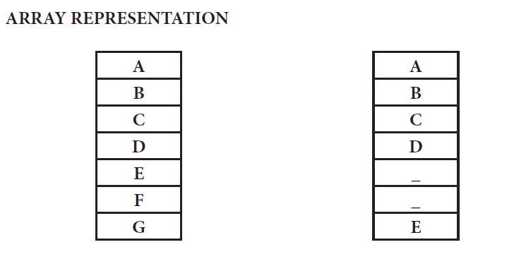
Array Representation of a Tree

Slide 33
Linked List Representation of a Tree
The most popular and practical way of representing a binary tree is using linked list (or pointers).
In linked list, every element is represented as nodes.
A node consists of three fields such as :
    Left Child (Lchild)
    Information of the Node (Info)
    Right Child (Rchild)
The LChild links to the left child node of parent node, Info holds the information of every node and RChild holds the address of right child node of parent node.

Slide 34
Linked List Representation of a Tree
G
If a node has no left and/or right node, corresponding LChild and RChild is assigned to NULL.

Slide 35
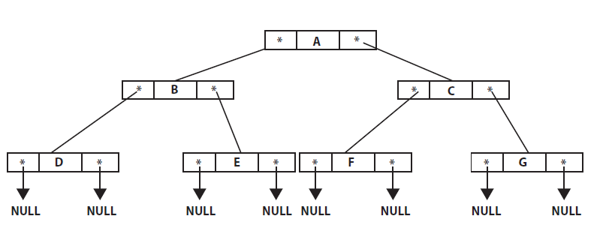
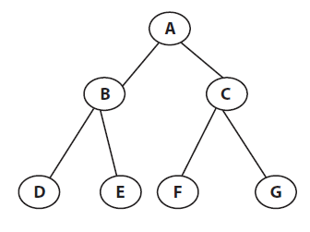
Linked List Representation of a Tree

Slide 36
Operations on Binary Tree
The basic operations that are commonly performed on binary tree is listed below:
    Create an empty Binary Tree
    Traversing a Binary Tree
    Inserting a New Node
    Deleting a Node
    Searching for a Node
    Copying the mirror image of a tree
    Determine the total number of Nodes
    Determine the total number leaf Nodes
    Determine the total number non leaf Nodes
    Find the smallest element in a Node
    Finding the largest element
    Find the Height of the tree
    Finding the Father, Left Child, Right Child, or Brother of an arbitrary node

Slide 37
Traversing Binary Trees Recursively
Tree traversal is one of the most common operations performed on tree data structures.
It is a way in which each node in the tree is visited exactly once in a systematic manner.
There are three standard ways of traversing a binary tree.
They are:
      Pre Order Traversal (Node-left-right)
      In order Traversal (Left-node-right)
      Post Order Traversal (Left-right-node)

Slide 38
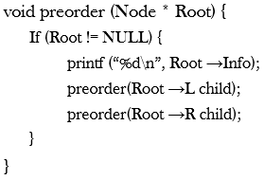
Traversing Binary Trees Recursively
Pre Order Traversal Recursively (Node-left-right):
To traverse a non empty binary tree in pre order traversal follow the following:
      Visit the root node
      Traverse the left sub tree in preorder
      Traverse the right sub tree in preorder
That is, in preorder traversal, the root node is visited (or processed) first, before traveling through left and right sub trees recursively.
It can be implemented in C in the following a way:

Slide 39
Traversing Binary Trees Recursively
Pre Order Traversal Recursively (Node-left-right):
Example:
The preorder traversal of a binary tree in Fig. above is A, B, D, E, H, I, C, F, G, J.

Slide 40
Traversing Binary Trees Recursively
In Order Traversal Recursively (left-Node-right):
The in order traversal of a non empty binary tree is defined as follows :
    Traverse the left sub tree in order
    Visit the root node
    Traverse the right sub tree in order
In order traversal, the left sub tree is traversed recursively, before visiting the root.
After visiting the root the right sub tree is traversed recursively, in order fashion.
It can be implemented in C in the following a way:

Slide 41
Traversing Binary Trees Recursively
In Order Traversal Recursively (left-Node-right):
Example:
The preorder traversal of a binary tree in Fig. above is D, B, H, E, I, A, F, C, J, G.

Slide 42
Traversing Binary Trees Recursively
Post Order Traversal Recursively (left-right-Node):
The post order traversal of a non empty binary tree can be defined as :
      Traverse the left sub tree in post order
      Traverse the right sub tree in post order
      Visit the root node
In Post Order traversal, the left and right sub tree(s) are recursively processed before visiting the root.
It can be implemented in C in such a way:

Slide 43
Traversing Binary Trees Recursively
Post Order Traversal Recursively (left-right-Node):
Example:
The preorder traversal of a binary tree in Fig. above is D, H, I, E, B, F, J, G, C, A.

Slide 44


